Slide 1
Summary
Identify the location of the stamp
Based on the location of the stamp extract region of interest (ROI) (Crop the area around the stamp)
Perform text detection using OpenCV on the ROI and extract the text next to the stamp
Select possible statements from a dictionary
One of the possible statements is the text on the header of the image file. Using OpenCV we can extract the header texts.
Compare the extracted texts at step 3 and step 4
Code:
https://github.com/henockmamo54/DocIdentification/blob/dev/_stampLocationIdentification/__LocationAndTextMatching.py

Slide 2
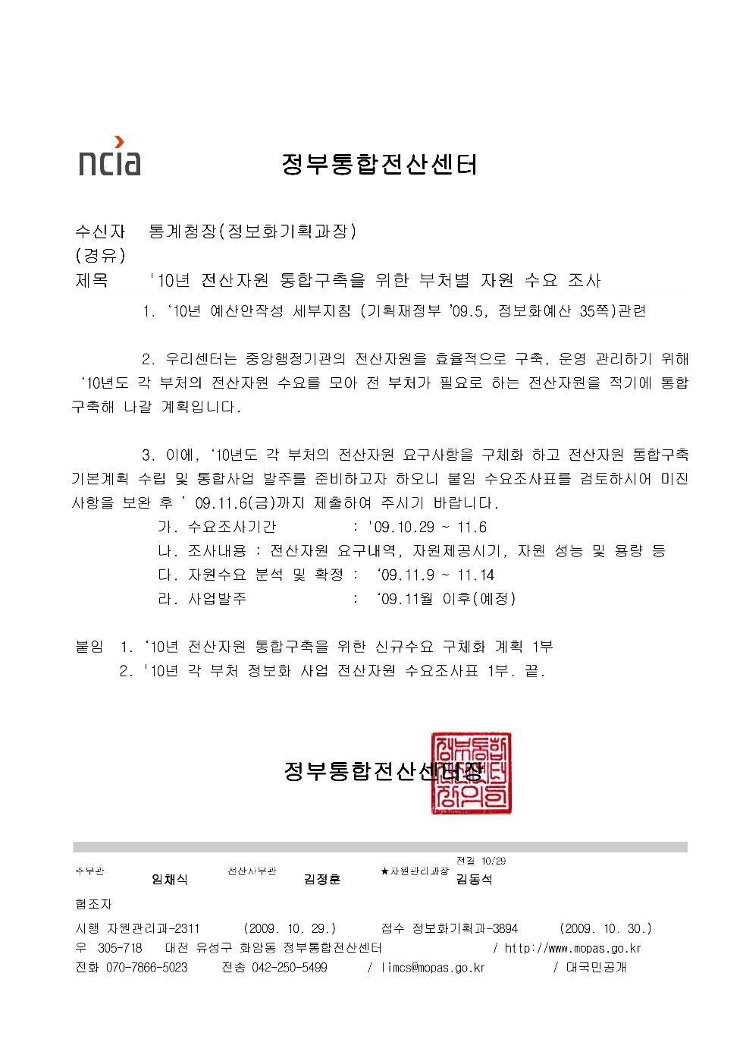


2
3
정부통함전산섹싸쟁
1

Slide 3
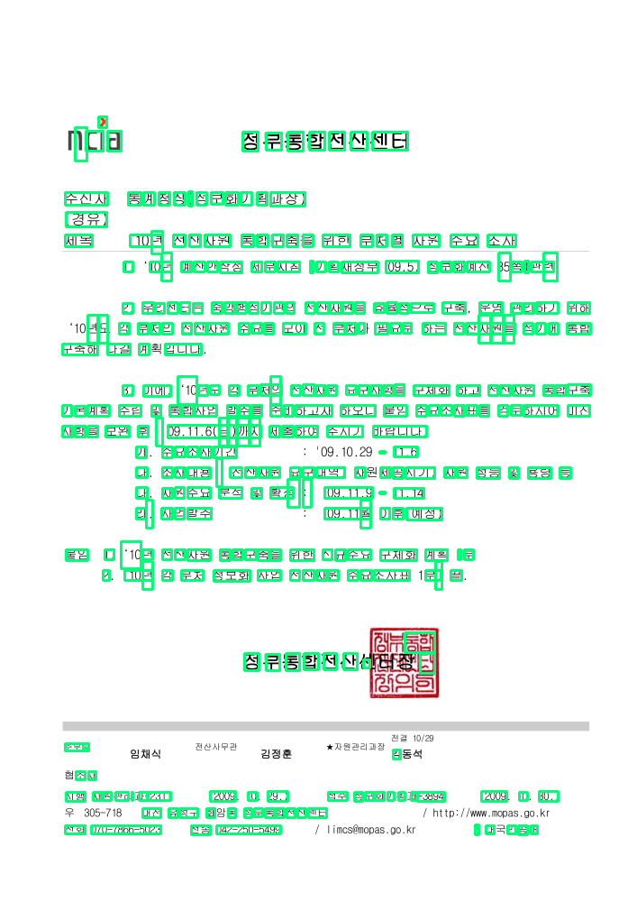
4
~|정부통합전산센던
5
Compare statements 3 & 4
정부통함전산섹싸쟁
3
~|정부통합전산센던
4

